Slide 1
Future Simple Will-Future

Slide 2
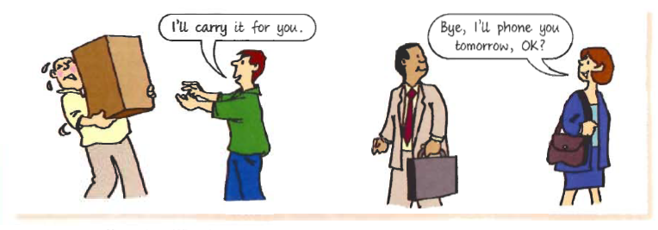
I will have a cup of coffee and a cheesecake.
FOR INSTANT DECISIONS
I will find the right job one day.
TO GIVE PREDICTIONS WITHOUT EVIDENCE
I will call you as soon as I arrive.
TO MAKE PROMISES
Signal words: tomorrow, next week, next weekend, a few days, weeks, years later

Slide 3
Future Simple - affirmative
I
You
He/She/It
We
You
They
will
stay
at home.
´ll
Subject + ´ll/will + infinitive without to

Slide 4
Future Simple - negative
I
You
He/She/It
We
You
They
will not
travel
this summer.
won‘t
Subject + won‘t/will not + infinitive without to

Slide 5
Future Simple - Questions
Will
I
you
he/she/it
we
you
they
go
to school in June?
When
will
go
to school ?
will + subject + infinitive without to
Question word + will + subject + infinitive without to

Slide 6
Exercise: Ask for the underlined word(s)
I will go shopping next Monday.
When
will
you
go
shopping?
I will go shopping next Monday.
What
will
you
do
next Monday?
Billie Eilish won‘t play any concerts this summer.
Who
won‘t
play
any concerts this summer?

Slide 7
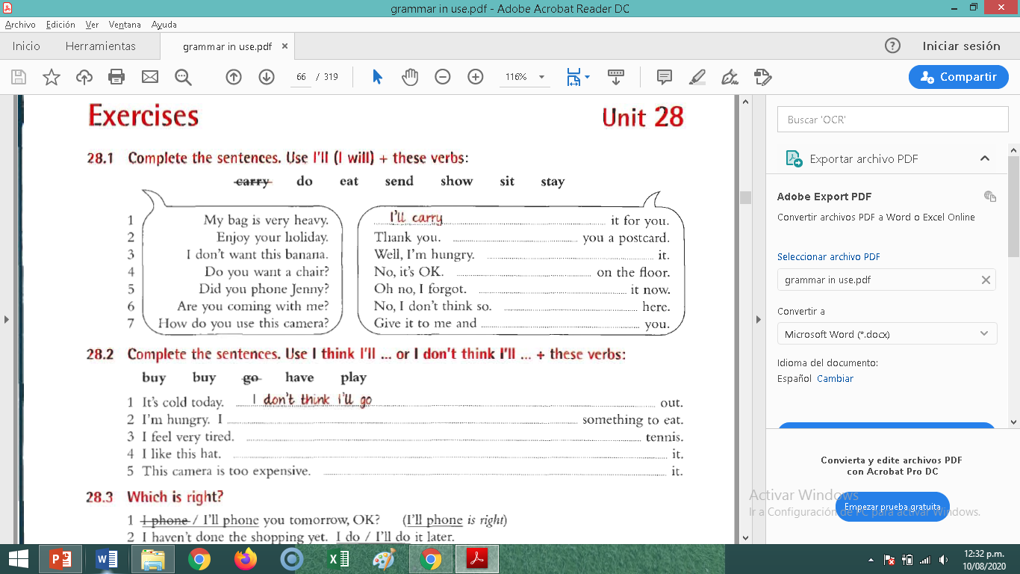

Slide 8
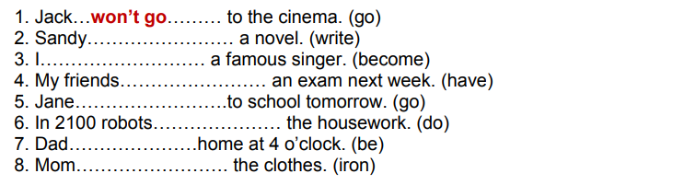

Slide 9
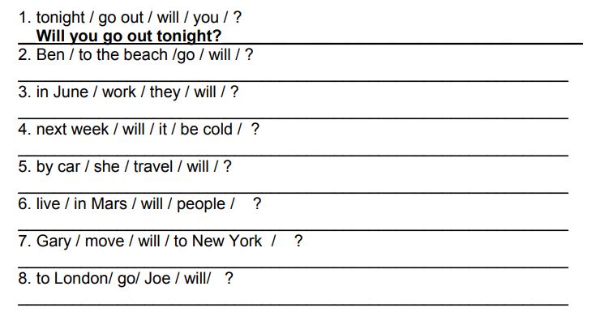

Slide 10
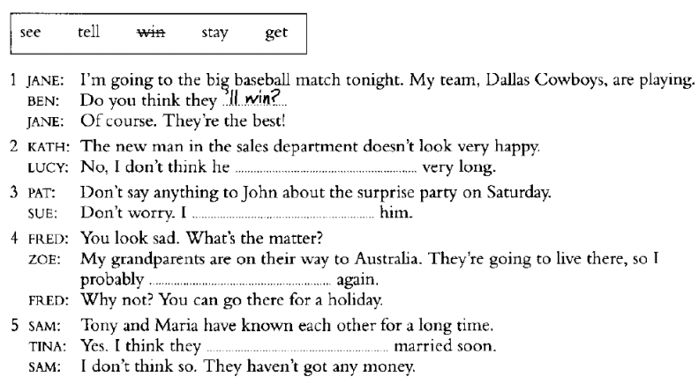

Slide 11
